Slide 1
CONTENT BASED IMAGE RETRIEVAL USING COLOR AND TEXTURE
Presented by
KRISH JAIN

Slide 2
INTRODUCTION
WHAT IS CBIR ?
CONTENT BASED IMAGE RETRIEVAL (CBIR) is a technique which uses visual content such as color and texture for searching similar images from large scale image database according to user request in the form of query image.
The visual content of the images in the data base are extracted and described by multi dimensional feature vectors.
The similarities/distances between the feature vectors of the of the query image and those of the images in the database are then calculated and retrieval is performed with the aid of an indexing scheme.

Slide 3
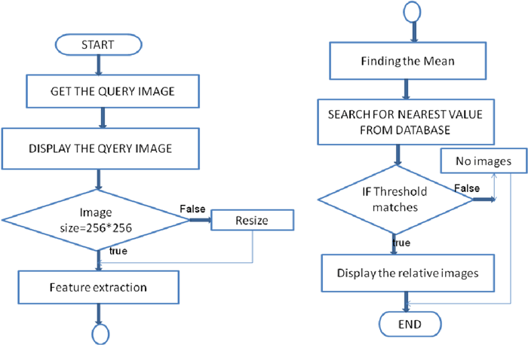
How CBIR works?

Slide 4
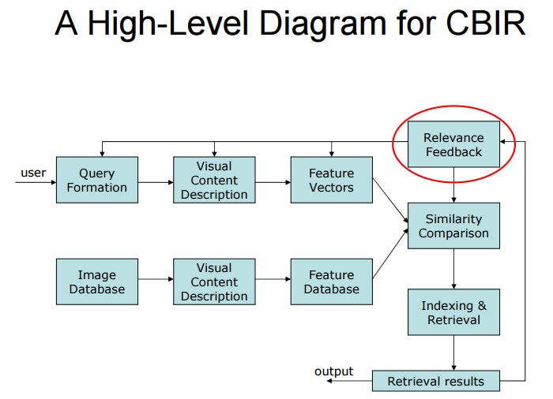
How CBIR works?

Slide 5
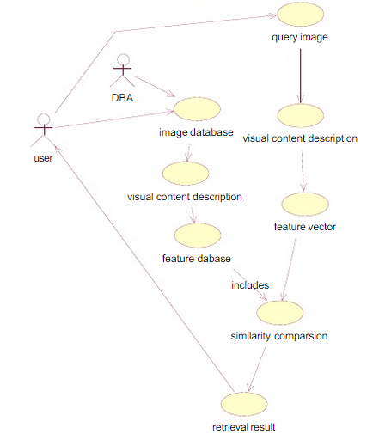
USECASE DIAGRAM

Slide 6
COLOR FEATURE EXTRACTION USING HSV BINS
Color is a basic visual attribute for both human perception and computer vision and one of the most widely used visual features in image retrieval.
Examining images based on the colors they contain is one of the most widely used techniques because it does not depend on image size or orientation.
So even though if one image is same domain but in different color mean it will not retrieved the image

Slide 7
Understanding the Concept of Histogram Bins
HSV Color Space
The HSV color space is developed to provide an intuitive representation of color and to approximate the way in which humans perceive and manipulate color.
The hue (H) represents the dominant spectral component—color in its pure form, as in green, red, or yellow. Adding white to the pure color changes the color: the less white, the more saturated the color is. This corresponds to the saturation (S). The value (V) corresponds to the brightness of color .

Slide 8
Understanding Histogram Bins
The HSV space is uniformly quantized into a total of 256 bins. This includes 4 levels in H, two levels in S, and two levels in V.
In HSV color space each component is quantized in non-equal intervals, where H : 16 bins, S : 4 bins and V : 4 bins. Finally, these 16X4X4 bins are concatenated to obtain a 256 dimensional vector .
Advantages of using Histogram Bins in HSV Color Space
The quantization of the number of colors into several histogram bins is done in order to decrease the number of colors used in image retrieval .Therefore Histogram Bins are used in HSV Color Space which helps us in achieving better retrieval efficiency .

Slide 9
Algorithm
1. Read the query image from user.
2. Convert RGB color space into HSV color space.
3. Quantize each pixel in HSV space to 256
Histogram bins.
4. The normalized histogram is obtained by dividing
with the total number of pixels.
5. Store the 256 values as color feature vector in
feature vector database.
6. Calculate the similarity measure of query image
and the image present in the database using
Euclidean Distance.
7. Retrieve the images based on minimum distance.

Slide 10
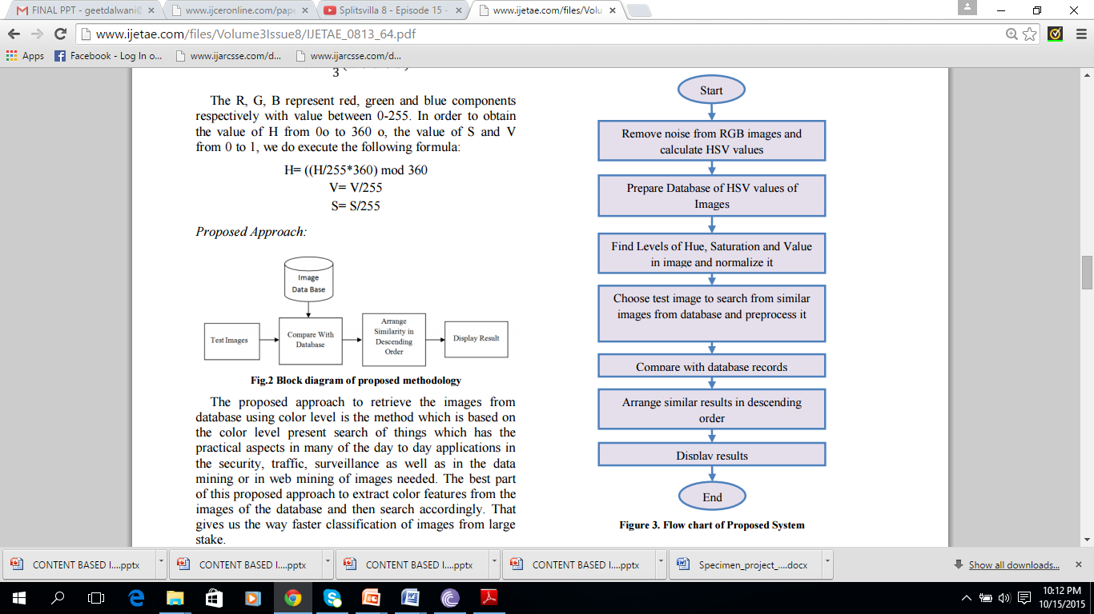
Flowchart for the Proposed System

Slide 11
COLOR FEATURE EXTRACTION USING HSV BINS AND TEXTURE FEATURE EXTRACTION USING GLCM MATRIX
Texture gives us information about the spatial arrangement of the colors or intensities in an image.
Texture measures look for visual patterns in images and how they are spatially defined.
Textures are complex visual patterns composed of entities, or sub patterns which have brightness, color, slope, size, etc.
Texture is a rich source of visual information about the nature and three dimensional shapes of physical objects.
The identification of specific textures in an image is achieved primarily by modeling texture as a two-dimensional gray level variation.
Texture is another feature that can help to segment images into regions of interest and to classify those regions.

Slide 12
Understanding a Gray-Level Co-Occurrence Matrix
Grey Level Co-occurrence Matrix (GLCM) is a widely used texture descriptor, a co-occurrence occurrence matrix, also referred to as a co-occurrence distribution, is defined over an image to be the distribution of co-occurring values at a given offset.
Grey Level Co-occurrence Matrix (GLCM) is a widely used texture descriptor and it is proven that results obtained from the co-occurrence matrix are better than the other texture discriminations methods.
The GLCM is a tabulation of how often different combinations of pixel brightness values (gray levels) occur in an image.
The GLCM is created from a gray-scale image. The GLCM calculates how often a pixel with gray-level value i occurs either horizontally, occurs either horizontally, vertically, or diagonally to adjacent pixels vertically, or diagonally to adjacent pixels with the value with the value j .

Slide 13

Understanding a Gray-Level Co-Occurrence Matrix
Offset is an array of integers specifying the distance between the pixel of interest and its neighbor. Each row in the array is a two-element vector, [row_offset, col_offset], that specifies the relationship, or offset, of a pair of pixels. row_offset is the number of rows between the pixel-of-interest and its neighbor. col_offset is the number of columns between the pixel-of-interest and its neighbor.
The figure illustrates the array: offset = [0 1; -1 1; -1 0; -1 -1]

Slide 14
Understanding a Gray-Level Co-Occurrence Matrix
To create a GLCM, graycomatrix function is used which creates a gray-level co-occurrence matrix where each element (i,j) in the resultant glcm matrix is simply the sum of the number of times that the pixel with value I occurred in the specified spatial relationship to a pixel with value j in the input image.
The number of gray levels in the image determines the size of the GLCM. By default, graycomatrix uses scaling to reduce the number of intensity values in an image to eight.
graycoprops normalizes the gray-level co-occurrence matrix (GLCM) so that the sum of its elements is equal to 1.

Slide 15
Understanding a Gray-Level Co-Occurrence Matrix
Graycoprops uses the normalized GLCM to calculate following properties:-
Contrast: Returns a measure of the intensity contrast between a pixel and its neighbor over the whole image
Correlation: Returns a measure of how correlated a pixel is to its neighbor over the whole image.
Energy: Returns the sum of squared elements in the GLCM.
Homogeneity: Returns a value that measures the closeness of the distribution of elements in the GLCM to the GLCM diagonal.

Slide 16
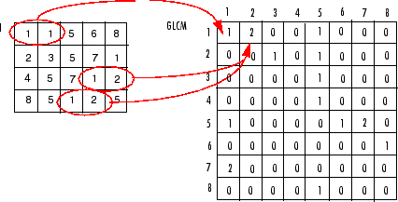
Process Used to Create the GLCM

Slide 17
Algorithm
1. Read the query image from user.
2. Convert RGB query image to Grey Scale image.
3. Compute four GLCM matrices for each direction
4. For each GLCM matrix compute the statistical features such as Energy, Homogeneity, Contrast
and Correlation.
5. Compare similarity matching of database image with query image using distance metrics.
6. Retrieve the top 20 images based on minimum distance.

Slide 18
COLOR FEATURE EXTRACTION USING MEAN AND TEXTURE FEATURE EXTRACTION USING STANDARD DEVIATION
Color Feature Extraction Using Mean
Steps to be followed to extract the color feature :
1. Read query image from user.
2. Extract the RGB components from the image and calculate their means individually.
3. The RGB component of each pixel is compared with the results obtained in step 2 for each component.
4. If the comparison performed in step 3 results true, then RGB component of each pixel is assigned to RH,GH and BH respectively otherwise, to RL,BL and GL respectively.
5. Calculate the mean of RH, RL, GH, GL, BH, BL and store it into a color feature vector in database.
6. Calculate the similarity measurement of query image with the image present in database using Euclidean distance.
7. Retrieve the images based on a minimum distance.

Slide 19
Texture Feature Extraction Using Standard Deviation
Standard Deviation is a measure that is used to quantify the variation or dispersion of a set of data values.
Steps to be followed to extract the texture feature :
Read the query image from the user.
Extract the RGB component from the image and extract their means individually.
The RGB component of each pixel is compared with the results obtained in step 2 for each component.
If the comparison performed in step 3 results true, then RGB component of each pixel is assigned to RH, GH and BH respectively otherwise, to RL, GL and BL respectively.
Calculate the mean of RH, RL, GH, GL, BH, and BL and store it into a single feature vector w [0...5].
Repeat step 3 for all images in database.
Calculate the standard deviation for RH, RL, GH, GL, BH, and BL and store it into texture feature vector.
Compare similarity matching of query image and database image using distance metrics.
Retrieve the images based on a minimum distance.

Slide 20
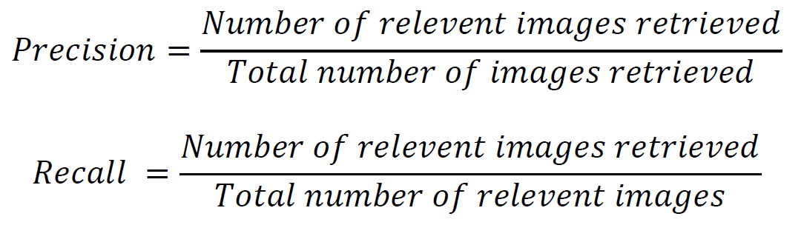
PRECISION & RECALL

Slide 21
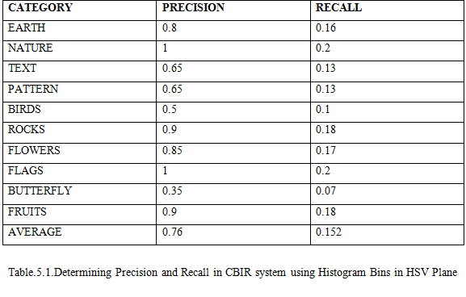
PRECISION AND RECALL TABLE

Slide 22
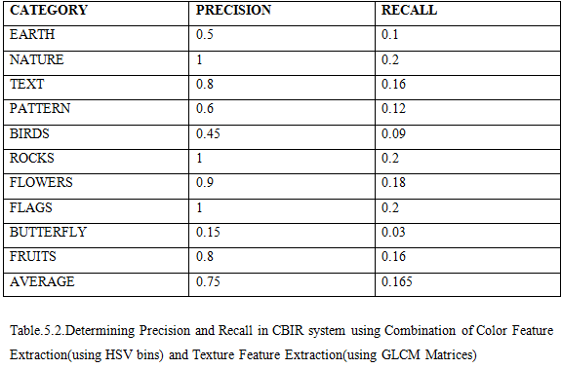
PRECISION AND RECALL TABLE

Slide 23
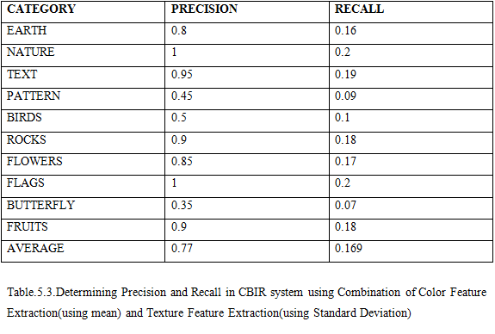
PRECISION AND RECALL TABLE

Slide 24
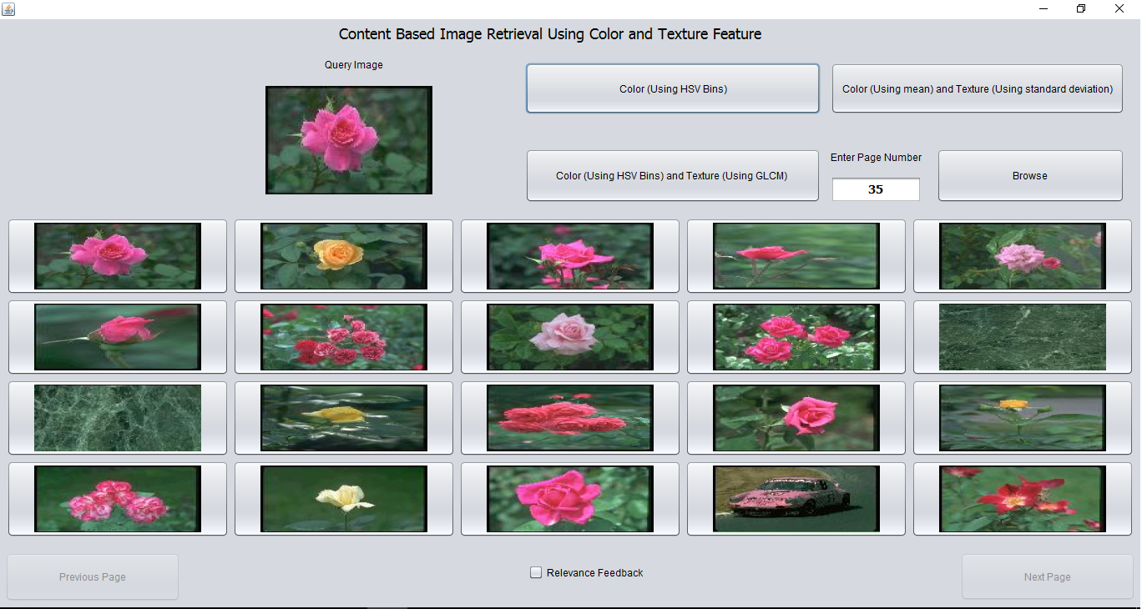
GUI: COLOR USING HSV BINS

Slide 25
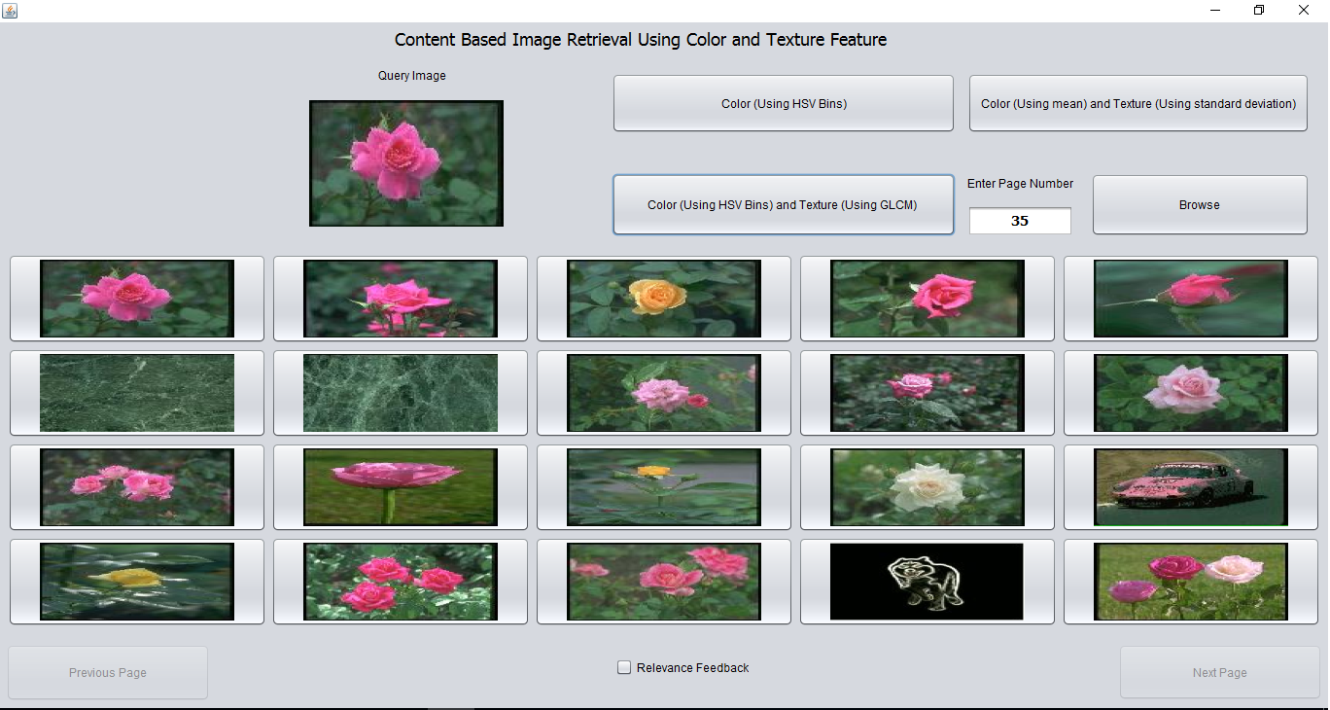
GUI: COLOR USING HSV BINS AND TEXTURE USING GLCM MATRIX

Slide 26
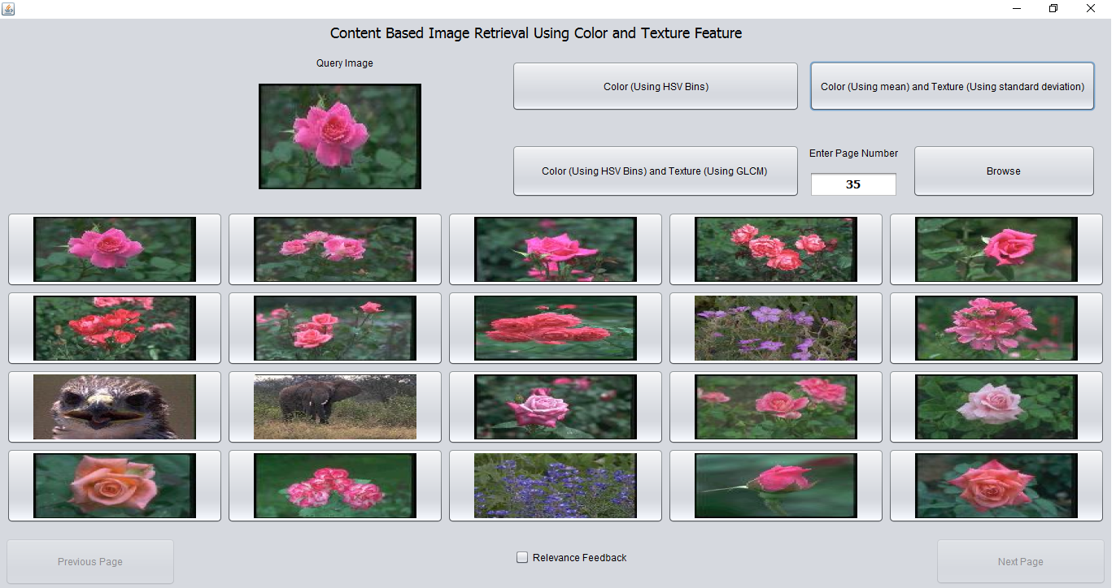
GUI: COLOR USING MEAN AND TEXTURE USING STANDARD DEVIATION

Slide 27
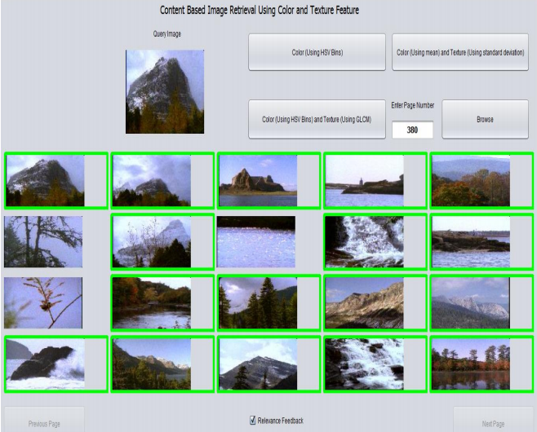
GUI:RELEVANCE FEEDBACK

Slide 28
APPLICATIONS
Potential uses for CBIR include:
Art collections
Crime prevention
Intellectual property
Medical diagnosis
Military
Face Finding

Slide 29
CONCLUSION
CBIR is used to search a specific image from a large database…
CBIR makes interactive search of images from the database…
At present this technique is implemented by Google…
THANK YOU

